Slide 1
Overactive bladder syndrome /Urge incontinence treatment
By:
Mozhdeh Moradi MD
Department of OB & GYN

Slide 2
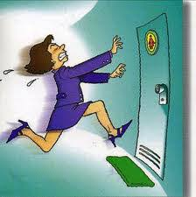
Urgency urinary incontinence
Urgency urinary incontinence describes having the urge to void immediately preceding or accompanying involuntary urine leakage.
Overactive bladder (OAB) is a syndrome characterized by urinary urgency, with or without incontinence, nocturia, and urinary frequency.

Slide 3
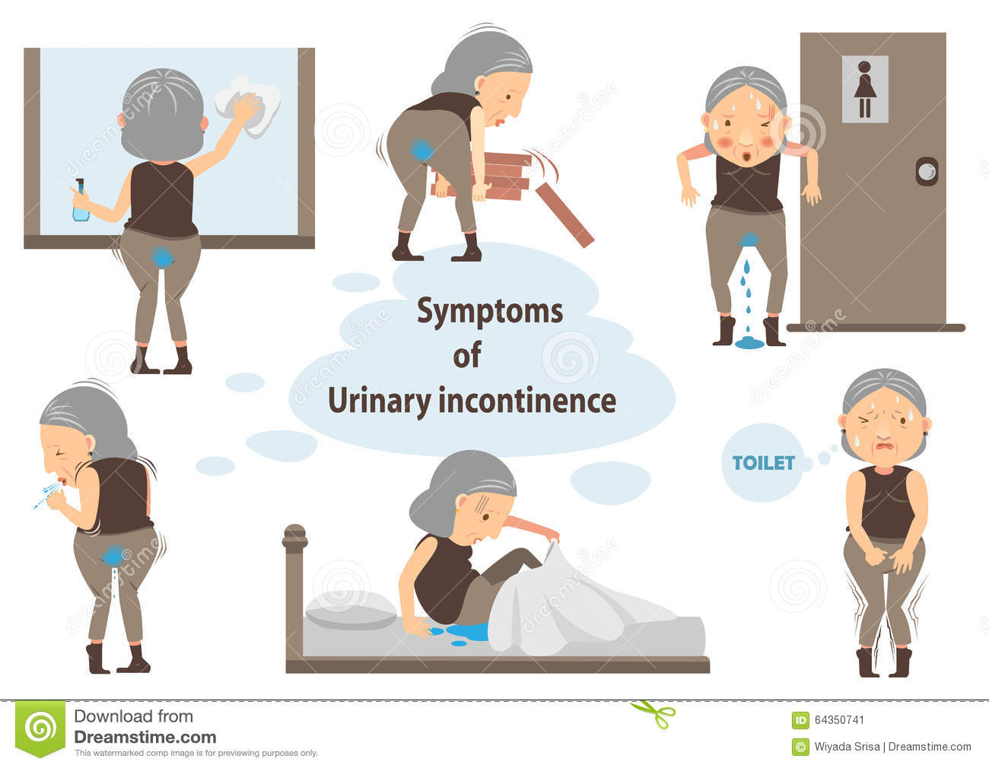

Slide 4
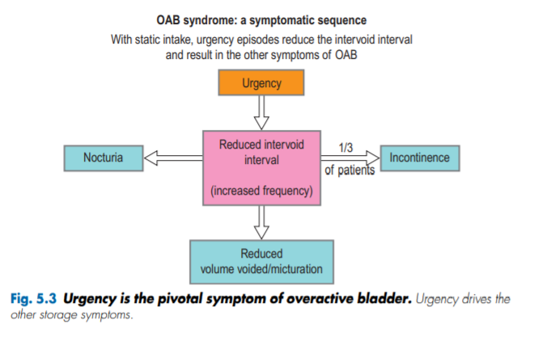

Slide 5
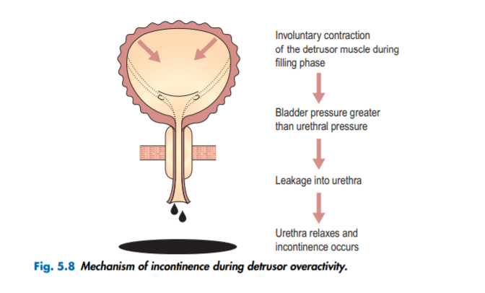

Slide 6
Prior to initiating treatment
Identify indications for referral :
the sudden onset of incontinence(particularly with additional neurologic symptoms)
presence of associated abdominal/pelvic pain
gross or microscopic hematuria in the absence of urinary tract infection
culture-documented recurrent urinary tract infections

Slide 7
Prior to initiating treatment
new neurologic symptoms
suspected urinary fistula or urethral diverticulum
chronic catheterization
difficulty passing a urinary catheter
history of pelvic reconstructive surgery or pelvic irradiation, urinary retention

Slide 8
Prior to initiating treatment:
Assess incontinence type and severity:
Determining the classification of urinary incontinence type (stress, urgency, mixed) can help direct treatment.
Treatment of urinary incontinence should proceed in a stepwise fashion with emphasis on improving quality of life.

Slide 9
Prior to initiating treatment
Risks and side effects of therapy should be carefully balanced with benefits and aligned with patient goals and expectations.
While most women with incontinence will have an improvement in symptoms with therapy, some do not achieve full continence. Expectations about the effect of treatment should be discussed with the patient when initiating therapy.

Slide 10
Prior to initiating treatment:
Voiding diary :
A baseline assessment of symptom severity with a voiding diary provides insight into fluid intake and output that can be used to counsel women about appropriate fluid intake, voiding frequency and bladder volumes. A voiding diary can also give an objective assessment of severity and may be helpful in assessing impact of treatment.

Slide 11
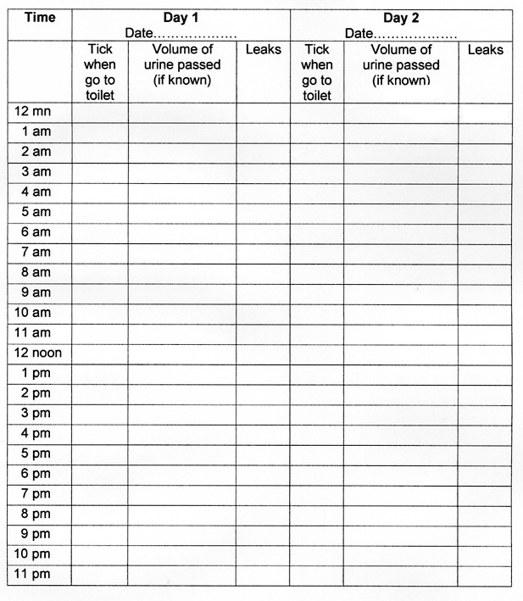

Slide 13
Prior to initiating treatment:
Quality of life assessment:
Tools are available to assess the impact of incontinence on a patient's quality of life, which can aid in :
baseline assessment
focus treatment goals
and evaluate treatment efficacy
Tools that patients can complete include the International Consultation on Incontinence Questionnaire.

Slide 14
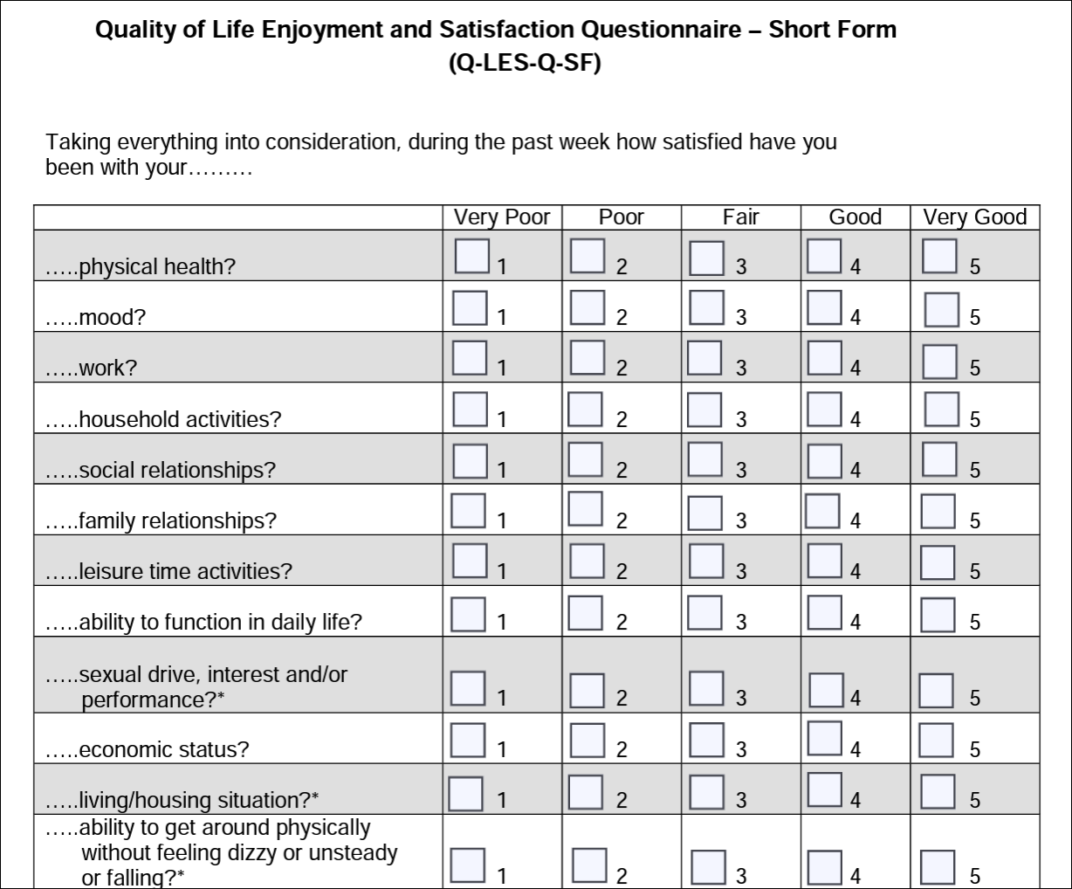

Slide 15
INITIAL TREATMENT
Initial treatments for most types of incontinence (stress, urgency, or mixed) include lifestyle modifications and pelvic floor muscle exercise, along with bladder training in women with urgency incontinence and in some women with stress incontinence . We typically treat with these conservative therapies for six weeks before considering subsequent therapies. Assuming evidence of some progress, it is also reasonable to treat with conservative therapies for up to six months, particularly in obese women who are likely to experience improved bladder control following weight loss.

Slide 16
INITIAL TREATMENT
Modifying contributory factors — Before starting any treatment for urinary incontinence, contributory factors such as medical conditions and medications should be addressed, particularly in older patients (
Lifestyle modification — Weight loss in obese women has many benefits, including improvement of urinary incontinence symptoms. Although commonly recommended and generally low risk, other lifestyle modifications that focus on, fluid restriction, and cdietary changes caffeine reduction have been less studied

Slide 17
INITIAL TREATMENT
●Weight loss – Obesity is a known risk factor for urinary incontinence, and weight loss in obese women appears to improve symptoms of urinary incontinence [Studies show greater benefits for stress incontinence than urgency incontinence.

Slide 18
INITIAL TREATMENT
●Dietary changes –reduce consumption of alcoholic, caffeinated, and carbonated beverages]. Women who are drinking excess amounts of liquids (>64 ounces of liquids) should normalize their fluid intake, unless there is a medical reason why they need to consume more liquids. We do not restrict fluid consumption below this level as this can lead to dehydration. Women are advised to consume liquids (mostly water) in small amounts of throughout the day,. decrease or eliminate liquid consumed after dinner (or within several hours before bedtime).
●Constipation increase the risks of urinary retention

Slide 19
INITIAL TREATMENT
Pelvic floor muscle (Kegel) exercises — we suggest pelvic floor muscle (Kegel) exercises for women with urinary incontinence, particularly stress urinary incontinence Pelvic muscle (Kegel) exercises strengthen the pelvic floor musculature to provide a backboard for the urethra to compress on and to reflexively inhibit detrusor contractions. Initial instructions — These exercises can be effective for both stress and urgency incontinenc). The basic regimen consists of three sets of 8 to 12 contractions sustained for 8 to 10 seconds each, performed three times a day]. Patients should try to do this every day and continue for at least 15 to 20 weeks A systematic review of randomized trials found that, compared with no treatment, women treated with pelvic muscle exercises were more likely to report improvement or cure of any urinary incontinence (67 versus 29 percent; relative risk [RR] 2.39; 95% CI 1.64-3.47).

Slide 20
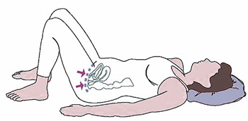

Slide 22
INITIAL TREATMENT
Patients have better outcomes with regular exercise and proper technique. Adequacy of pelvic floor muscle contraction can be assessed during the pelvic examination. The examiner places one or two fingers within the vagina and asks the patient to contract her pelvic floor using the same muscles she would use to stop urine flow or bowel gas . In women who are able to isolate their pelvic floor muscles to stop urine flow, verbal instruction on timing and frequency of exercise is usually sufficient. For those with difficulty identifying the proper muscles, supplemental modalities can help women to perform these exercises properly.

Slide 23
INITIAL TREATMENT
Supplemental modalities — For women who are able to isolate pelvic floor musculature, supplemental therapy may not be necessary. However, other patients may have difficulty because of poor muscle isolation, low motivation, or inability to properly contract the pelvic floor. For these patients, we use supplemental therapies such as supervised pelvic floor therapy, vaginal weighted cones, or biofeedback (based on patient preference, access, and availability)

Slide 24
INITIAL TREATMENT
●Supervised pelvic floor therapy – Women who have difficulty performing the exercises or have no improvement with unsupervised exercise may benefit from referral to a pelvic floor physical therapist or continence nurse where available Pelvic muscle exercises are most effective with specific instruction by health professionals and regular performance by motivated patients.

Slide 25
INITIAL TREATMENT
●Vaginal weighted cones
Vaginal weighted cones are available without a prescription and typically ordered from an online retailer or medical supply store. These may be preferable for women who have insufficient time or resources to dedicate to supervised physical therapy or biofeedback. The patient inserts the cone in the vagina and uses pelvic muscle contractions to hold it in place during activity.

Slide 26
INITIAL TREATMENT
●Biofeedback – Biofeedback as a supplement to pelvic muscle exercises is particularly useful in women who are unable to properly isolate the pelvic floor or use accessory muscles during pelvic floor contractions. This modality involves placement of a vaginal pressure sensor within the vagina that measures pressure and provides an audible or visual feedback of strength of pelvic floor contraction. Augmented versions also use abdominal and perineal electromyography (EMG) recordings to demonstrate improper contraction of abdominal and gluteal muscles.

Slide 27
INITIAL TREATMENT
Bladder training — Bladder training is most effective for women with urgency incontinence. Bladder training and pelvic muscle exercises are often used in combination with dietary and lifestyle modifications (eg, fluid restriction to 64 oz/day and avoidance of caffeinated beverages

Slide 28
INITIAL TREATMENT
Bladder training starts with timed voiding. Patients should keep a voiding diary to identify their shortest voiding interval. The using the shortest interval shortest voiding interval is used when initiating bladder training. The pathe voiding diary as the initial voiding interval. Urgency between votient is instructed to void by the clock at regular intervals while awake, between voids identified on iding times is controlled with either distraction or mental relaxation techniques (eg, performing mental math, deep breathing) along with quick contractions of the pelvic floor muscles "quick flicks" to suppress urgency and bladder contraction When the patient can avoid leakage for one day using the initial urination interval, the time between scheduled voids is increased by 15 minutes. The intervals are gradually increased until the patient is voiding every three to four hours without urinary incontinence or frequent urgency.

Slide 29
INITIAL TREATMENT
Successful bladder training can take up to six weeks. Patients often need encouragement and reassurance to continue despite initial lack of response.
Patients should be encouraged to void regularly even when outside of the home.

Slide 30
INITIAL TREATMENT
Topical vaginal estrogen — We suggest a trial of vaginal estrogen therapy for peri- or postmenopausal women with either stress or urgency incontinence and vaginal atrophy due to genitourinary syndrome of menopause (GSM). GSM is associated with urinary frequency and dysuria and]. Available preparations include creams, rings, gel caps, and tablets (can contribute to incontinence while treatment with topical estrogen has been associated with symptom improvement We use topical estrogen cream 0.5 gm twice weekly (conjugated estrogen or estradiol), estradiol tablet 10 mcg twice weekly, or the estradiol ring every three months. It may take up to three months for patients to perceive treatment benefit and some patients may require higher doses.,

Slide 31
INITIAL TREATMENT
We do not recommend systemic (oral) estrogen therapy for urinary incontinence. Evidence suggests that systemic hormone therapy may worsen urinary incontinence [
Systemic absorption is low with topical vaginal estrogen at the recommended

Slide 32
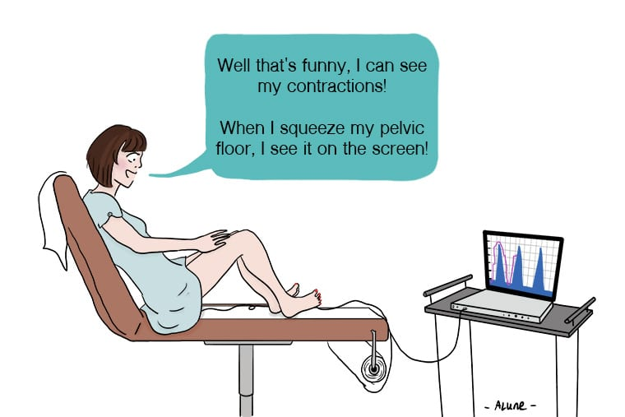
Biofeedback
Notes:
بیوفیدبک بعنوان مکمل آموزش مثانه و یا ورزش عضلات کف لگن در بعضی بیماران کمک کننده است. بیوفیدبک از طریق واژن انجام شده و به بیمار کمک می کند تا عضلات کف لگن را بشناسد و منقبض کرده و به حس فوریت ادراری پاسخ دهد.در این روش یک سنسور فشار در واژن قرار داده میشود و یک فیدبک دیداری و یا شنیداری را از انقباض عضلات کف لگن فراهم میکند. این روش بیشتر در کسانی بکار می رود که در رفتار درمانی اولیه بطول 4هفته دچار شکست شده باشند.همراهی بیوفیدبک و PFMT در مقایسه با PFMT به تنهایی تاثیر بیشتری در بهبود بیماران دارد

Slide 33
1:conservetive
2:medication
3:surgery
Treatment

Slide 36
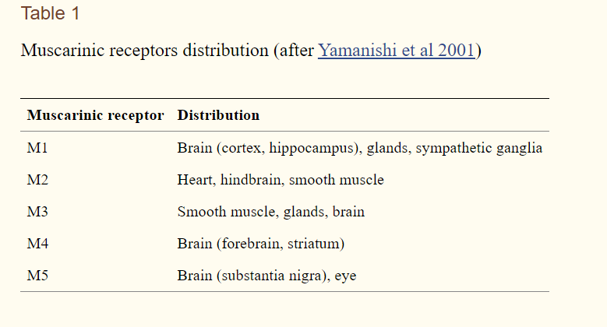

Slide 37
— Beta-3 adrenergic agonist drugs and antimuscarinic agents are the main options for treatment of OAB symptoms As efficacy is similar for the two groups, we and others suggest initial drug treatment with beta-3 adrenergic agonists because of the increased risk of side effects, including long-term risk of dementia, with anticholinergic drugs as reported in case-control and cohort studies . However, from a practical perspective, choice of initial agent is often influenced by third-party payor coverage, availability and cost. The beta-3 adrenergic agonists are a newer drug class and therefore, in the United States, tend to be more expensive with less coverage across insurance providers than anticholinergics.

Slide 38
Initial improvement in symptoms may be noted within the first two weeks of treatment but optimization of effect can take up to 12 weeks. We educate patients about these time intervals to avoid early medication discontinuation.

Slide 39
Beta-3 adrenergic agonist drugs
The beta-3 adrenergic agonists mirabegron and vibegron work by stimulating the receptors in the bladder responsible for smooth muscle relaxation . While trials that directly compare the two beta-3 agonists are lacking, two network meta-analyses suggest similar efficacy overall . Vibegron may have slightly larger reductions in mean voided volume and fewer nasopharyngeal and cardiovascular side effects, but the clinical significance of this is unclear . Compared with antimuscarinic medications, these drugs have similar efficacy with fewer adverse effects.

Slide 40
Antimuscarinic drugs
These agents are a subtype of anticholinergic agents; they block muscarinic receptor stimulation by acetylcholine and reduce smooth muscle contraction of the bladder . Such blockade during bladder storage results in increased bladder capacity and decreased urgency . Advantages include common availability, low-cost generic options, short- and long-acting formulations, and potential for combination therapy with beta-3 adrenergic agonists, but these medications also more frequently cause side effects as well as impact cognition.

Slide 41
●Common adverse effects include dry mouth, dry eye, and constipation. Patients with cognitive impairment, and older adults in general, are at increased susceptibility to adverse drug reactions from anticholinergic medications, including possible increased risk of dementia, which are discussed below.

Slide 42
●No or minimal improvement – For those with inadequate response, we confirm adherence to behavioral, dietary, lifestyle, and medication dosing. Next, these patients may benefit from drug adjustment (dose or class) or combination pharmacotherapy (antimuscarinic plus beta-3 adrenergic agonist) . If the patient has some improvement and is willing to give the initial drug choice more time and is tolerating the medication, we titrate the drug up to maximum tolerated dose before switching to another agent.

Slide 43
Partial response
For patients whose symptoms improve and who are tolerating the medication, we increase the medication dose and reassess in four to six additional weeks. Dose increases can continue to the maximum . Patients with partial response on maximum drug dose may benefit from combination treatment with a drug from the other class (antimuscarinic or beta-3 adrenergic agonist). Adverse effects with combination therapy are not anticipated to be additive, but supporting data are limited. An antimuscarinic (solifenacin or trospium) and mirabegron are commonly used for combination therapy . Dose increase and combination therapy are discussed in detail separately.
●Intolerable side effects – Patients with intolerable side effects are advised to stop the medication. Those who have tried only one medication class are offered a trial of the alternate class. Individuals who have experienced intolerable side effects with both medication classes are offered advanced treatment including percutaneous tibial nerve stimulation (PTNS), botulinum toxin, or sacral nerve stimulation (SNS).

Slide 44
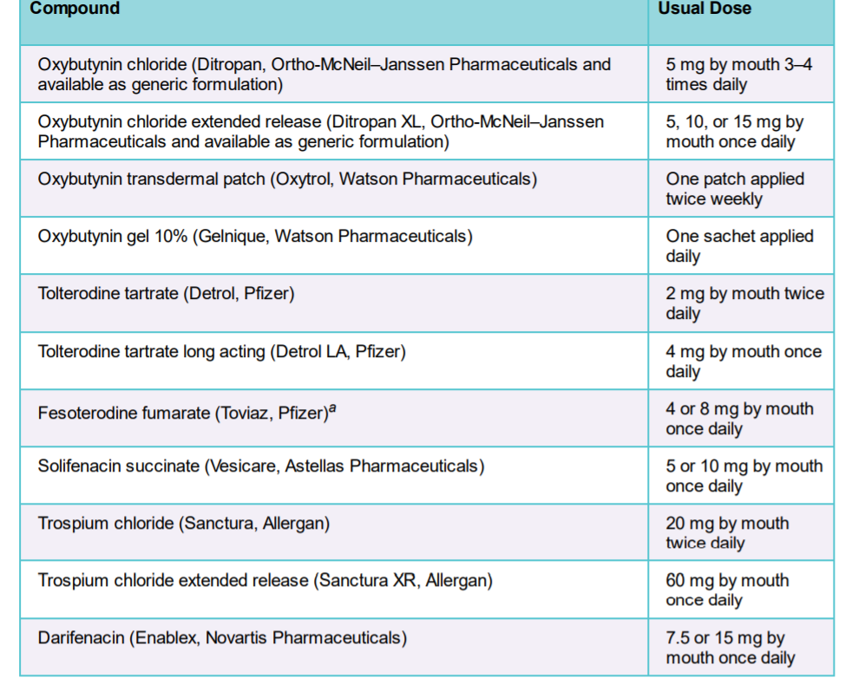
Anti Muscarinic

Slide 45
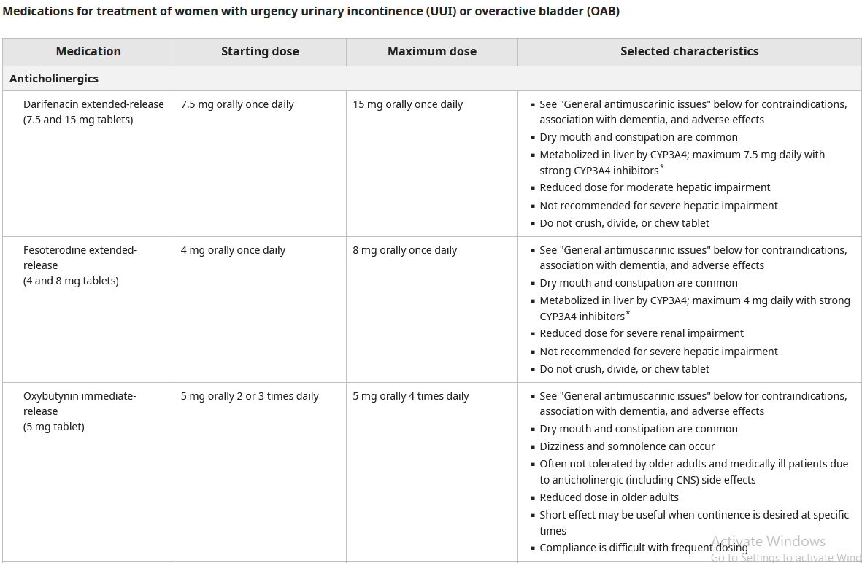

Slide 46
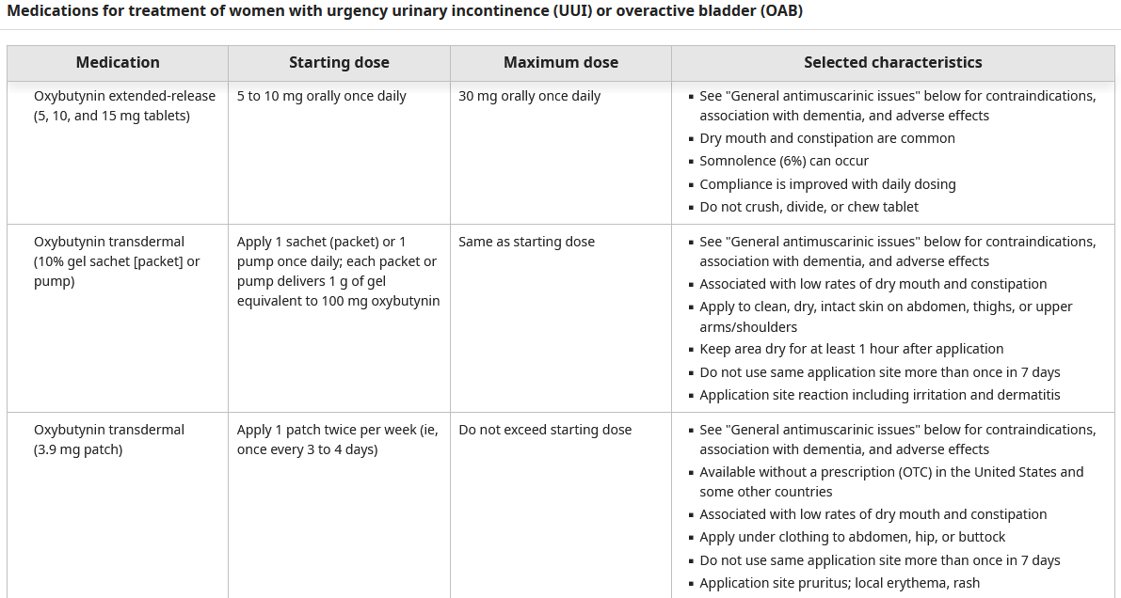

Slide 47
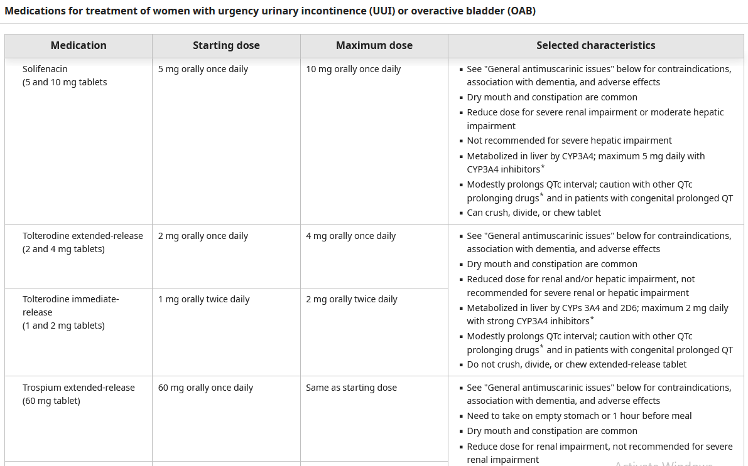

Slide 48
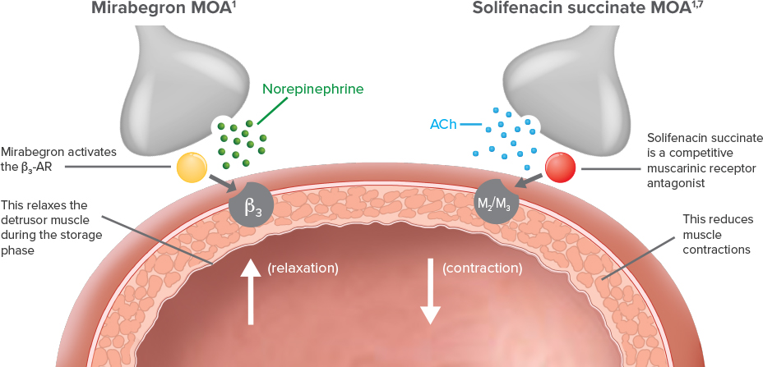

Slide 49
solifenacin 5 mg or 10 mg
COMBINED THERAPY
mirabegron 25 mg or 50 mg

Slide 50
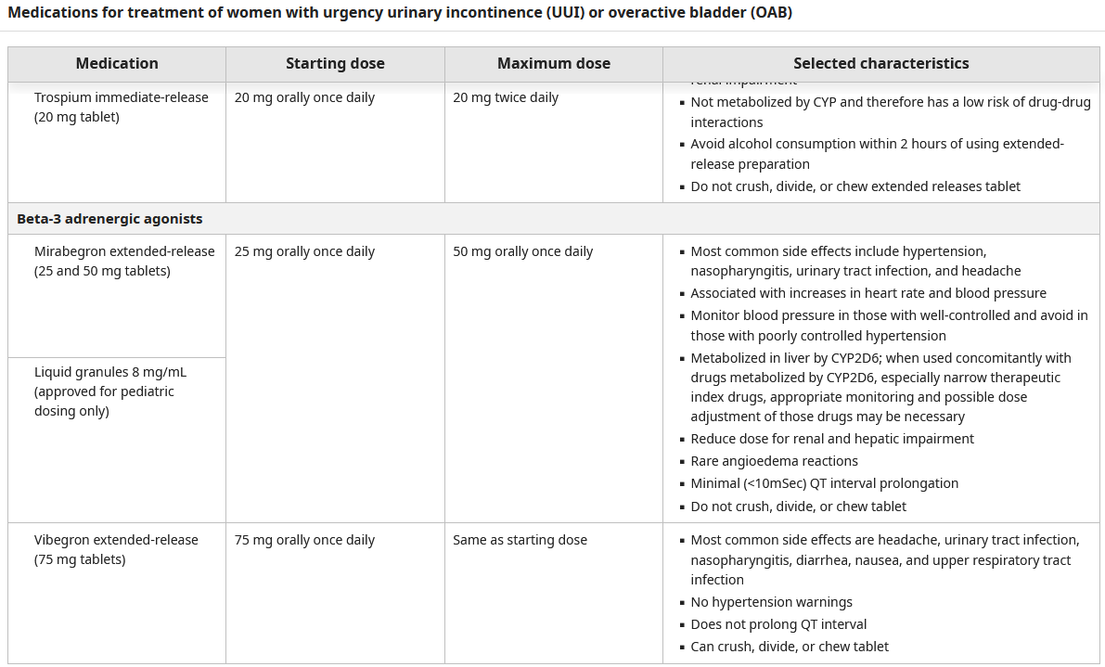

Slide 52
PATIENTS WITH CONTINUED SYMPTOMS
Patients who have persistent urgency urinary incontinence or other irritative symptoms despite an adequate trial of initial treatments and pharmacotherapies, or who are unable to tolerate pharmacologic therapy, can be referred to a specialist to discuss further options for treatment . In general, we try at least two pharmacotherapies prior to advanced therapies.
Advanced therapies range from noninvasive office-based acupuncture-like nerve stimulation (PTNS) and office-based injections of botulinum toxin A to surgically implanted nerve stimulation devices (tibial nerve stimulation and SNM)

Slide 53
Selection of therapy — The selection of advanced therapy should be based on a detailed discussion with the patient regarding safety, efficacy, and time commitment as well as consideration of insurance coverage for the various approaches. In general, we promote the least invasive approaches to advanced therapy first unless patients have specific time or financial considerations. In the United States, this approach typically results in initial trial of PTNS or transcutaneous tibial nerve stimulation (TTNS), although European countries consider PTNS a first-line approach, on par with medication . Individuals who are unsatisfied with the results of nerve stimulation or unable to undergo regular treatments are next offered either detrusor botulinum toxin injections or sacral nerve stimulation (SNS) . Botulinum toxin injections are typically administered in the office with no surgical preparation or recovery time, last between 6 to 12 months, and have been shown to be more cost-effective than historic modes of SNS . The advent of magnetic resonance imaging (MRI) compatible and rechargeable implanted programmable devices may result in improved cost-effectiveness of modern SNS implants; however, data are lacking.

Slide 54
Tibial nerve stimulation
Treatment options
•Percutaneous stimulation of the tibial nerve – PTNS, one type of electrical stimulation therapy, benefits some patients with detrusor overactivity and may be more effective than antimuscarinic drugs at reducing the number of urgency incontinence episodes . In an office setting, a clinician (nurse or physician) places an acupuncture-like needle medially behind the ankle and administers mild electrical stimulation for 30 minutes. These sessions occur once a week for 12 weeks followed by maintenance therapy of approximately once a month if the patient desires. Optimal duration of treatment and timing of maintenance therapy has not been established. An observational study of 470 women undergoing PTNS reported 71 percent of patients completed all 12 weeks of treatment; of those, 30 percent achieved success by eight weeks and 41 percent achieved success by 12 weeks based on global impression of improvement and 10 point or more improvement in OAB questionnaire short-form scores . For individuals who receive peak effect prior to 12 weeks of completed PTNS sessions, it is not known if maintenance therapy started earlier than 12 weeks is as effective as if started after the anticipated 12 weeks.

Slide 55
Tibial nerve stimulation
Treatment options
Transcutaneous tibial nerve stimulation – TTNS, a variant of PTNS, may be offered to patients who are unable to attend in-office sessions . We believe TTNS offers a low-cost, convenient option for patients who are unwilling or unable to attend frequent office visits. Comparative efficacy to sham or other tibial nerve stimulation procedures are limited; however, risks and costs are relatively low. Thus, we offer this therapy for patients particularly if they are unwilling or unable to attend in-person PTNS sessions.

Slide 56
Implantable tibial nerve stimulator
Implantable wireless neurostimulation devices (eCoin Valencia Technologies and Revi Blue Wind Medical) are currently available for treatment of urgency urinary incontinence, with or without urinary urgency symptoms . The device is surgically implanted near the posterior tibial nerve as an office procedure and is stimulated intrinsically as a battery (eCoin) or externally (Revi).

Slide 57
The eCoin device, once programmed does not require routine office visits or patient activation of the device to control the stimulation. The Revi implant device is smaller than the eCoin and has no battery. The wearable unit uses magnetic coupling to transmit energy to the implant, which generates electrical pulses to stimulate the tibial nerve, but requires the patient to initiate the therapy or attend office visits to activate the device. Open labeled, single-assignment, industry-sponsored trials demonstrate improvements in urgency urinary incontinence episodes, urgency urinary symptoms, and quality of life in both male and female patients ; however, device-related adverse events are common. . Cost-effectiveness of these devices compared to other advanced therapies will help inform the role of implanted tibial nerve stimulation. From a practical standpoint, patients with severe lower extremity edema, neuropathy, or peripheral vascular disorders may not be ideal.

Slide 58
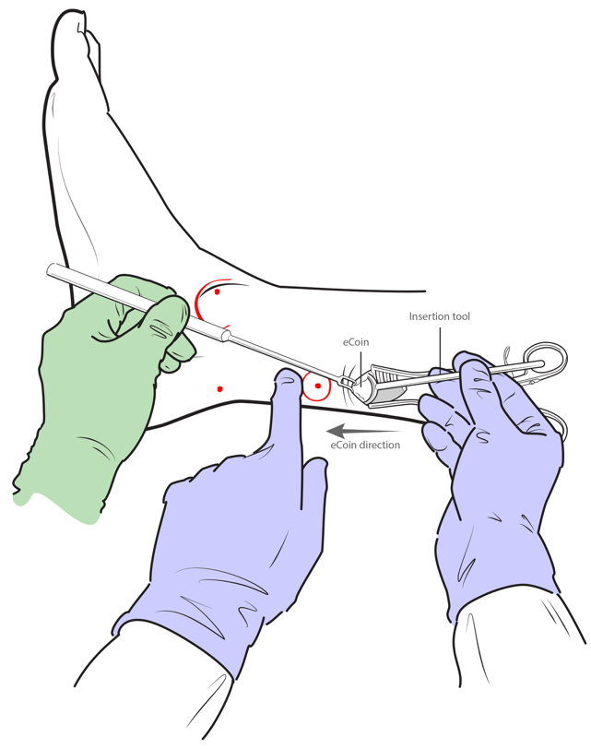

Slide 60
Botulinum toxin
— For patients with urgency or urgency-predominant mixed incontinence who do not respond to, or cannot tolerate pharmacotherapy, injection of botulinum toxin into the detrusor muscle is an option These injections are typically performed under local anesthesia in the office setting and do not require significant preparation or recovery. Onset of action occurs in approximately two weeks and duration of effect is reported between 3 and 12 months. In our practice, most patients require repeat injections every 9 to 12 months and patients can receive up to a total of 400 units in a year. Due to the known risk of transient urinary retention with botulinum toxin therapy, we generally avoid this therapy in patients with a history of urinary retention unless they are willing to learn self-catheterization. Botulinum toxin injection is also associated with increased rate of urinary tract infection and thus patients with recurrent urinary tract infections may not be optimal candidates.

Slide 61
Sacral nerve stimulation — Sacral nerve stimulation (SNS), also known as sacral neuromodulation (SNM), is a minimally invasive surgical electrical stimulation option to treat OAB symptoms that is offered to patients whose symptoms do not respond to initial interventions and pharmacotherapy .

Slide 62
جراحی
سیستوپلاستی تقویتی
تغییر مسیر ادراری
جایگذاری کاتتر سوپراپوبیک

Slide 63
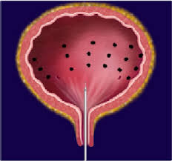

Slide 64
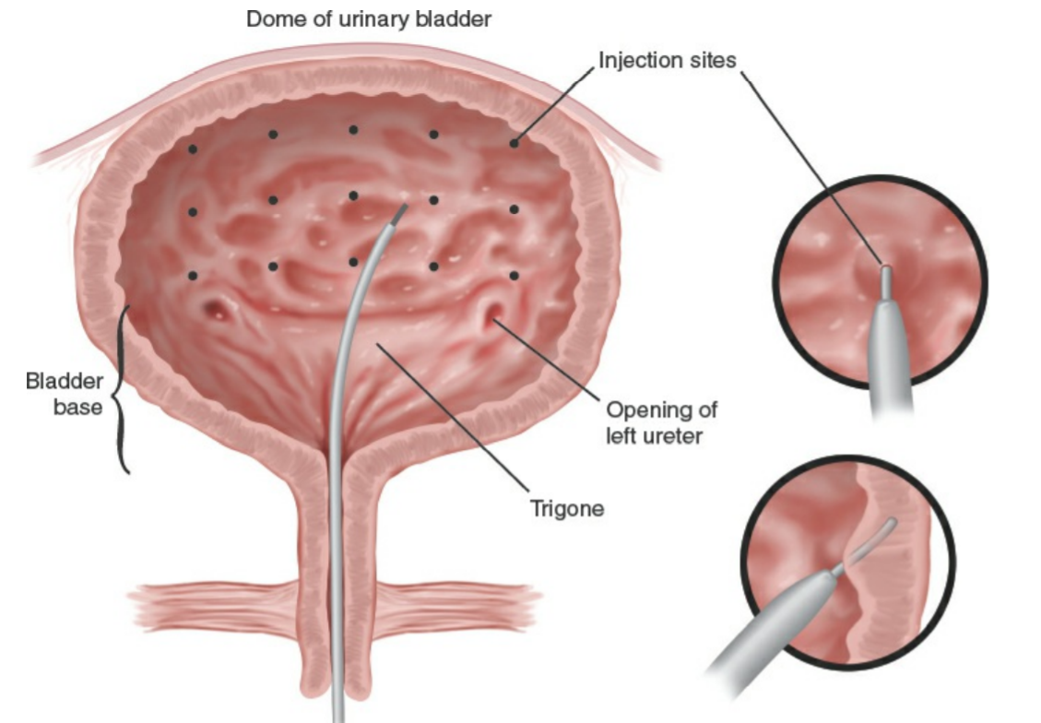

Slide 65
